Slide 1
An Advanced Approach on Predictive Modelling of Traffic Violations
Divya Jayaprakash Mayank Kothari
Shamsundar Kulkarni Vijay Shankar Balaji
Gautami Murugan

Slide 2
Objective
The main objectives of our project are:
Explore and analyze the perspective input parameters that impacts the severity of traffic violations.
Explore different data mining techniques to predict the reason of violations and property damages. To uncover the major relationship and patterns between different input variables and the target that are entirely categorical and nominal (absolutely no interval variables).

Slide 3
BI Model
Data Analysis
Data Collection
Data
Cleaning
Data
Reduction
Problem Definition
Managerial
conclusion
Descriptive Statistics
Predictive Modelling

Slide 4
Data Set Description
The data set used in this analysis is a second-hand dataset obtained from data.gov.
These data of traffic violations in Montgomery country of Maryland, from the U.S. government, can be used to predict whether the traffic violation would contribute to an accident, contribute to property damage or personal injury.
The data set consist a total of 825297 records with 35 parameters.

Slide 5
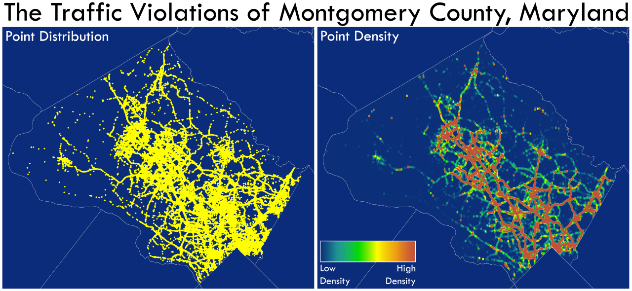
Visual Statistics

Slide 6
Cleaning and Preprocessing of Data
Our dataset is majorly categorical with the target variable values being ‘yes’ or ‘no’.
To build a proper model, the observations with target ‘no’ were under-sampled and observations with target ‘yes’ were oversampled in the train data. Certain columns had no variability at all in their values (all values were same throughout the column).
Our original dataset had 800000 observations from which we had to do a drastic data reduction. The train dataset was sampled as mentioned above.
Validation data set was randomly sampled, without any modification, from the original dataset of 800000 records.

Slide 7
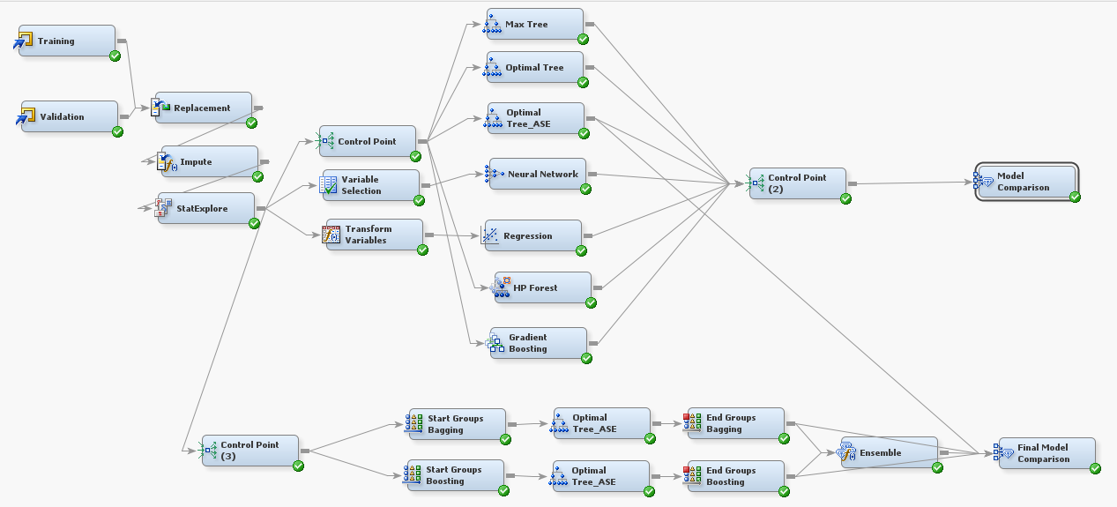
Enterprise Miner Diagram

Slide 8
Replacement Node
Few variables in the data set were not defined properly, for which we used the replacement node.
We replaced,
‘Ye’ to Yes
_UNKOWN_ to _DEFAULT_
Green, to Green
Blue, to Blue

Slide 9
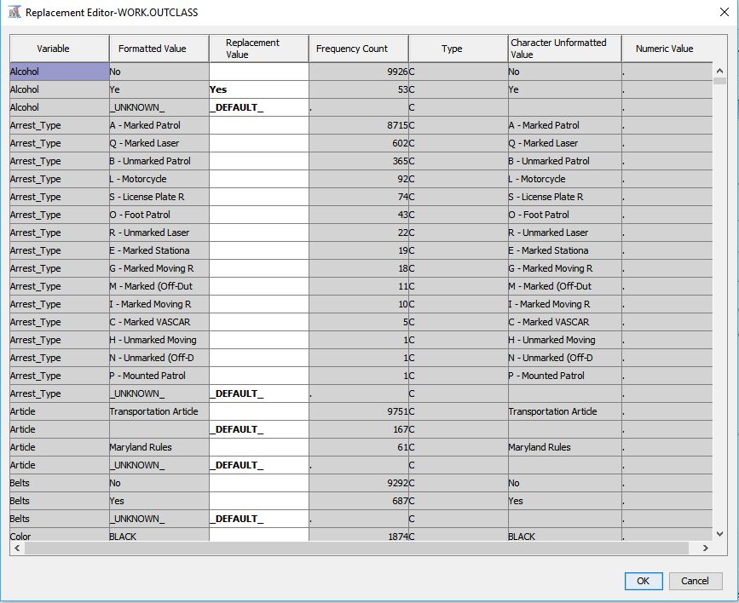
Replacement Node

Slide 10
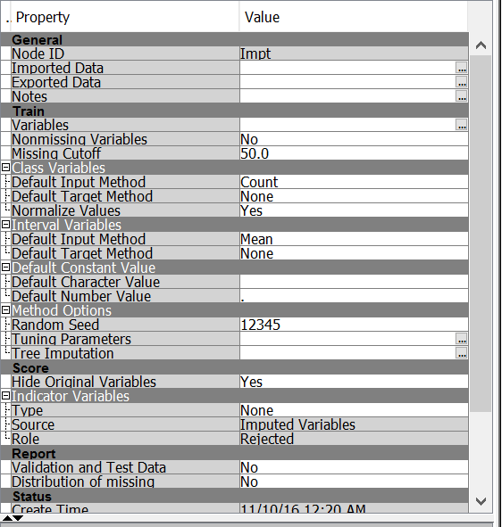
Impute Node
On exploration, it was found that some variables had missing values. We use the Impute node to populate the missing values. Below are the input methods for class and interval variables’ imputation:
Class Variables: Default Input Method – Count
Interval Variables: Default Input Method – Mean

Slide 11
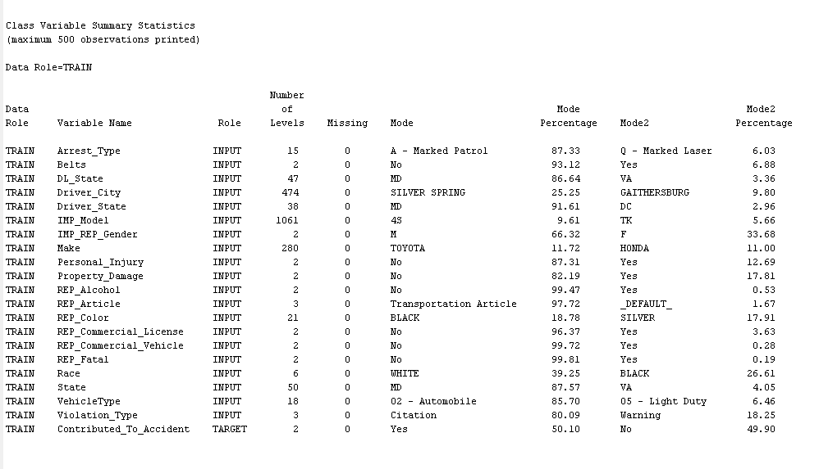
Stat Explore
We have used the Stat Explore node in SAS Enterprise Miner to produce analyze the statistical summary of our data.
From the Stat Explore result we can confirm we don’t have any missing values in the independent input variables used.

Slide 12
Transform Variables
It is known that the normally distributed input variables give accurate results. To avoid the distribution effect on the output, the variables that are extremely skewed are transformed. So, the transform variable node is used before logistic regression.

Slide 13
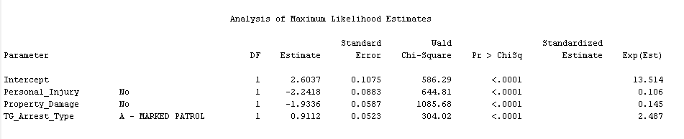
Logistics Regression
Logistic regression measures the relationship between the categorical dependent variable and one or more independent variables.
The variables have p-value <0.0001 which means that they are highly significant carrying a lot of information about the target variable.

Slide 14
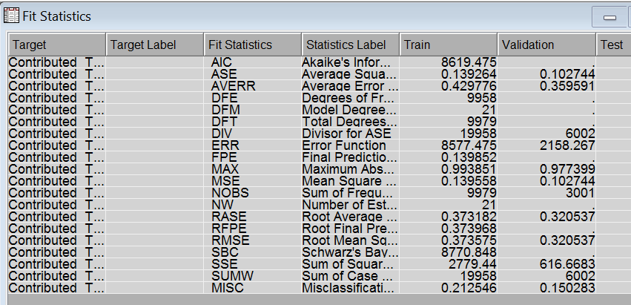
Logistics Regression
We can notice from the Fit Statistics that:
The Misclassification Rate for Train data is 0.212546 and Validation data is 0.150283
The Average Squared error for Train data is 0.139264 and Validation data: 0.102744

Slide 15
Decision tree
Decision tree provides an excellent introduction to predictive modeling. These models are conceptually easy to understand and they readily accommodate nonlinear associations between input variables and one or more target variables. We perform the following models
Max Tree
Optimal Tree - is grown with the ASSESSMENT MEASURE parameter set to “Decision”.
Optimal Tree ASE- is grown with the ASSESSMENT MEASURE parameter set to “Average Square Error”.

Slide 16
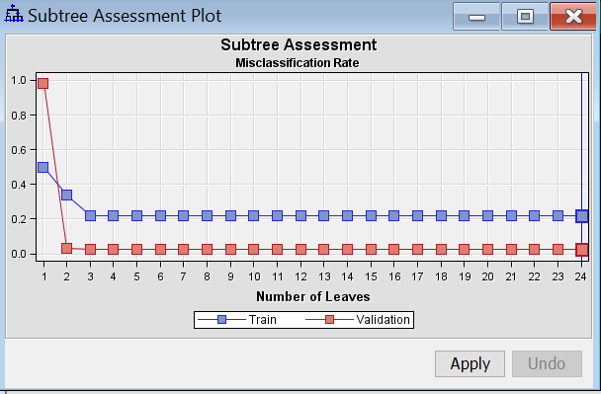
Max Tree- Sub tree assessment plot

Slide 17
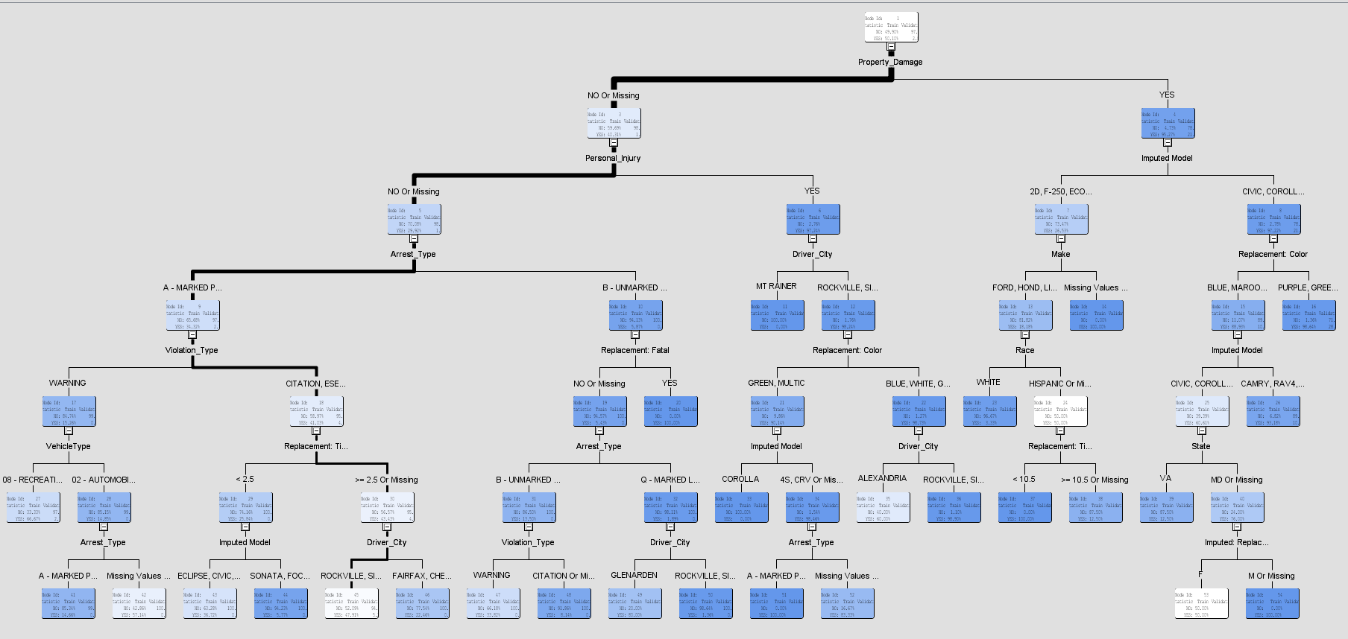
Max Tree- Tree Interpretation

Slide 18
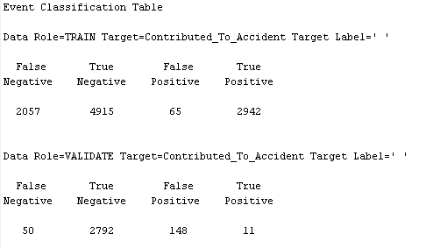
Max Tree Confusion Matrix
The model is good because the False Negative and False Positive counts are very less when compared to the True Negative and True positive counts respectively.

Slide 19
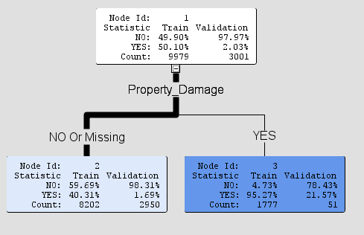
Optimal Decision Tree
Decision tree created setting ASSESSMENT MEASURE = DECISION
Existing Property Damage carries more
information in predicting
whether the accident has
happened or not
Almost a pure node that states that
amongst all traffic violation cases,
the vehicles that had an existing damage,
ended in fatal accident for 21.57% of times

Slide 20
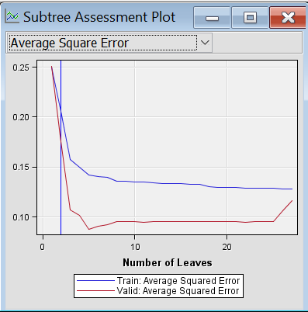
Optimal Tree- Subtree Assessment Plot

Slide 21
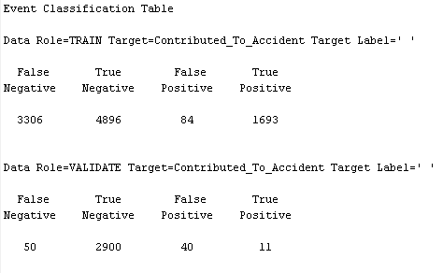
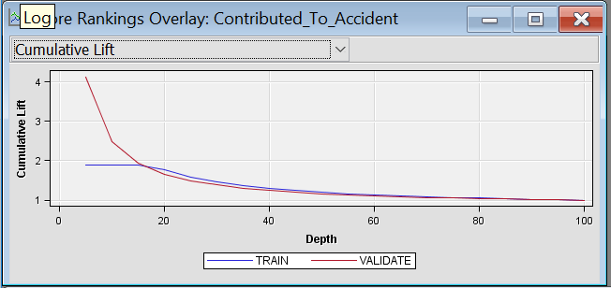
Optimal Tree Confusion Matrix
The model is good because the False Negative and False Positive counts are very less when compared to the True Negative and True positive counts respectively.

Slide 22
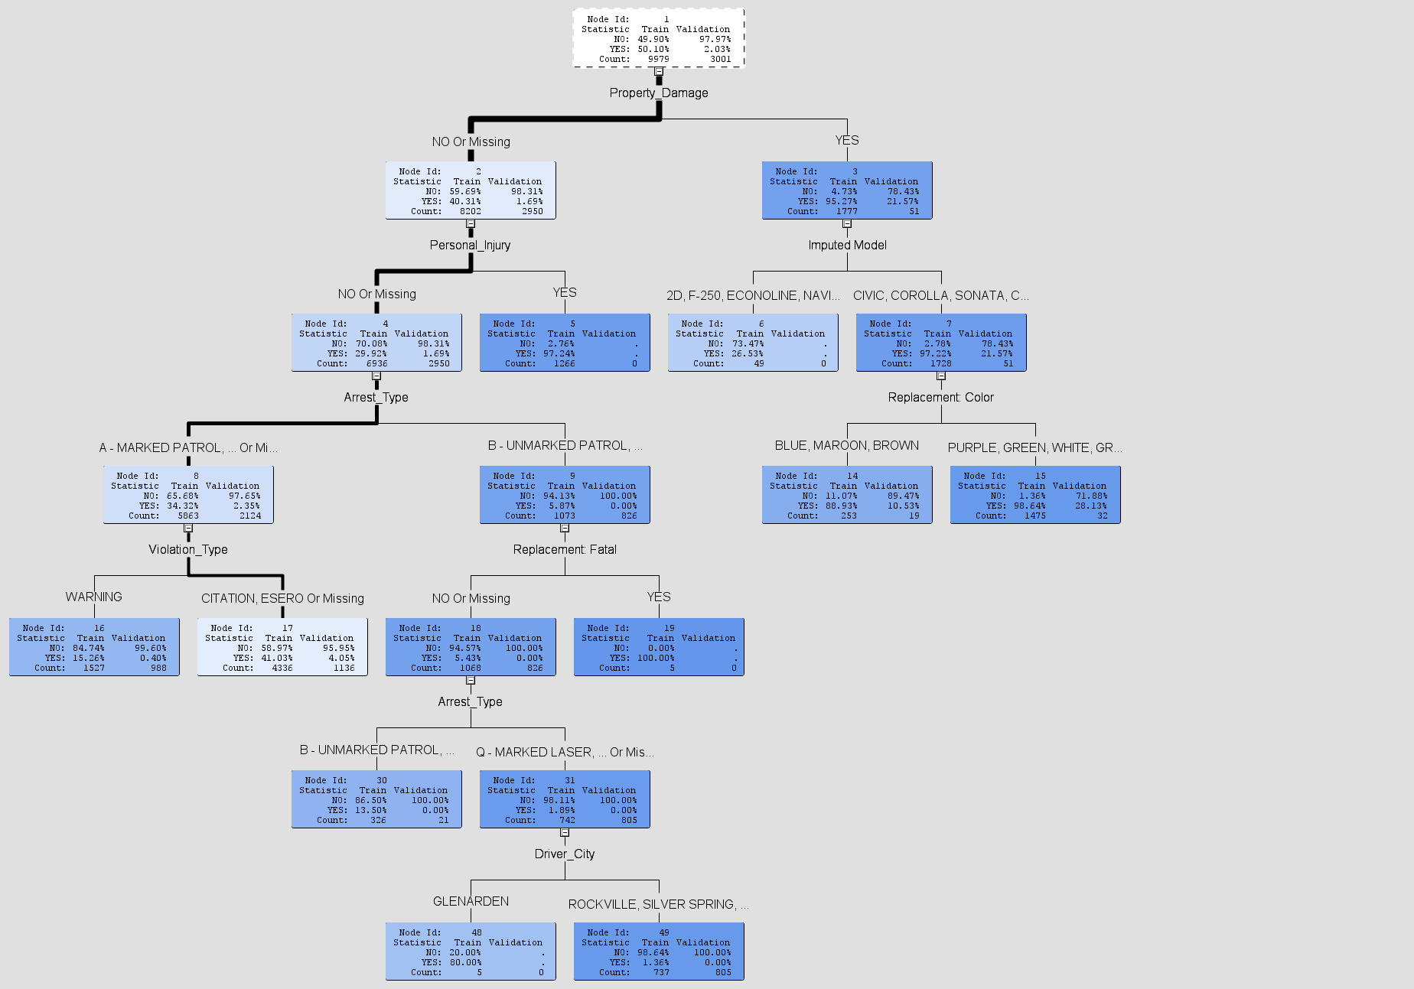
Optimal Tree ASE
These highly informative factors that
occur before accident and contribute to accident
They can be controlled by humans to prevent
accident
Bigger optimal tree : Assessment Measure = ASE
Car model , violation type,
driver city –good predictors of the target variable

Slide 23
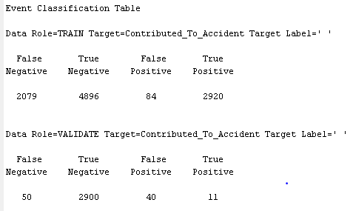
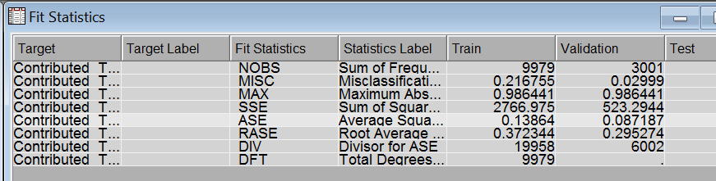
Optimal Tree ASE- Fit Stats and
We can notice from the Fit Statistics that:
The Misclassification Rate for Train data is 0.216755 and Validation data is 0.02999
The Average Squared error for Train data is 0.13864 and Validation data: 0.087187

Slide 24
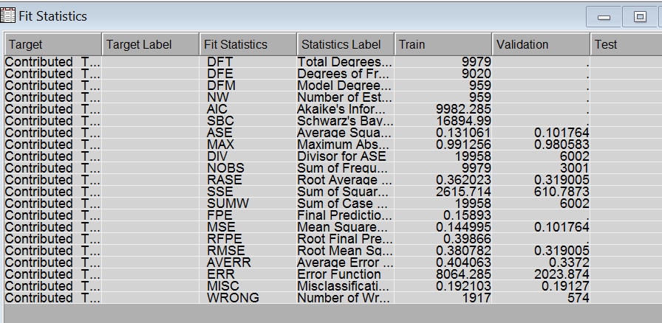
Neural Network
Compared to logistic regression, neutral network can well accommodate categorical predictors and binary target variable which were our biggest challenge
We can notice from the Fit Statistics that:
The Misclassification Rate for Train data is 0.192103 and Validation data is 0.19127
The Average Squared error for Train data is 0.131061 and Validation data: 0.101764

Slide 25
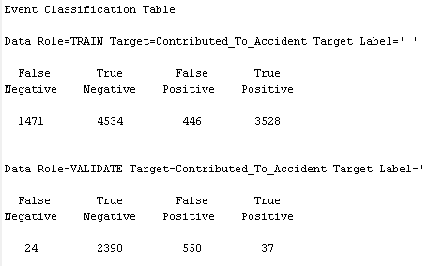
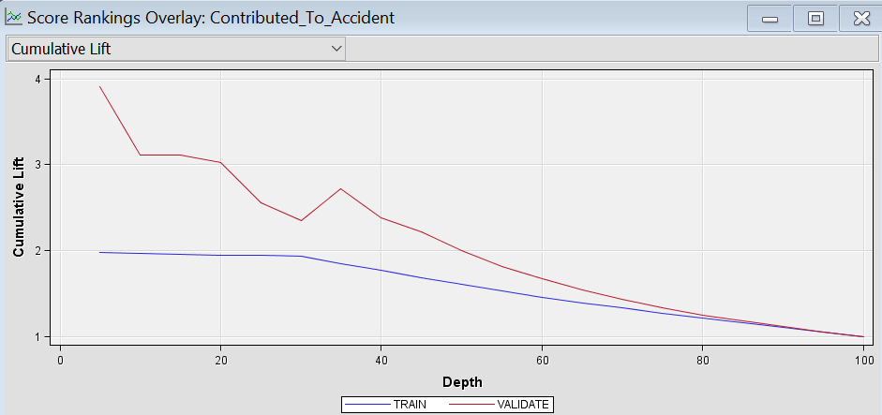
Neural Confusion Matrix and Cumulative lift graph

Slide 26
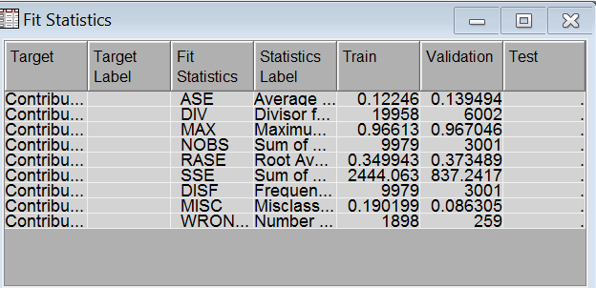
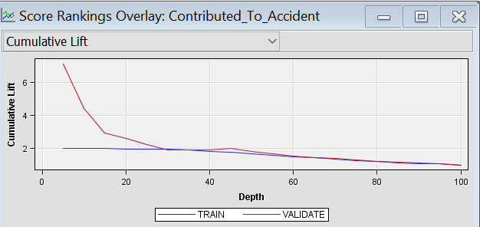
HP Forest
HP Forest is one of the best predictive models for extremely large nominal dataset. It creates several tree forests using random ensemble methodology and combines the predictions by voting for the target variables.

Slide 27
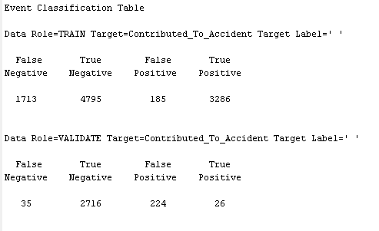
HP Forest
The low misclassification rate and the low average square error showcase that this model is a good model for this categorical dataset.

Slide 28
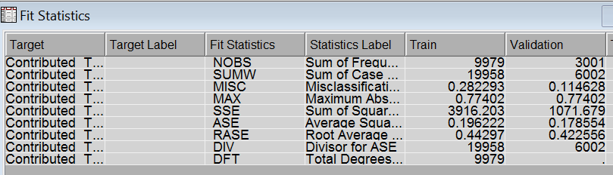
Gradient Boosting
Gradient boosting works on iterative sampling and modelling for the predicted target. In each iteration, the data to be trained is the data correctly classified from the previous iteration.
Misclassification rate:
Train: 0.282293, Validation: 0.114628
Avg. Square Error:
Train: 0.196222, Validation: 0.178554
Good Cumulative lift

Slide 29
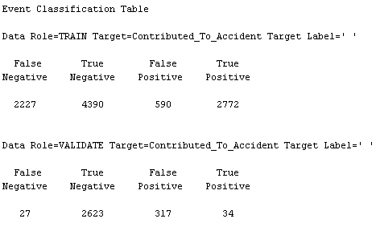
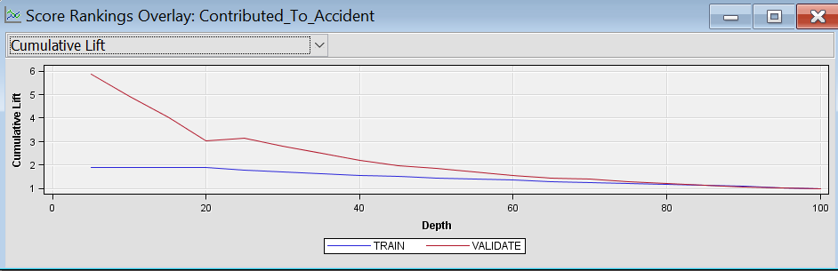
Gradient Boosting

Slide 30
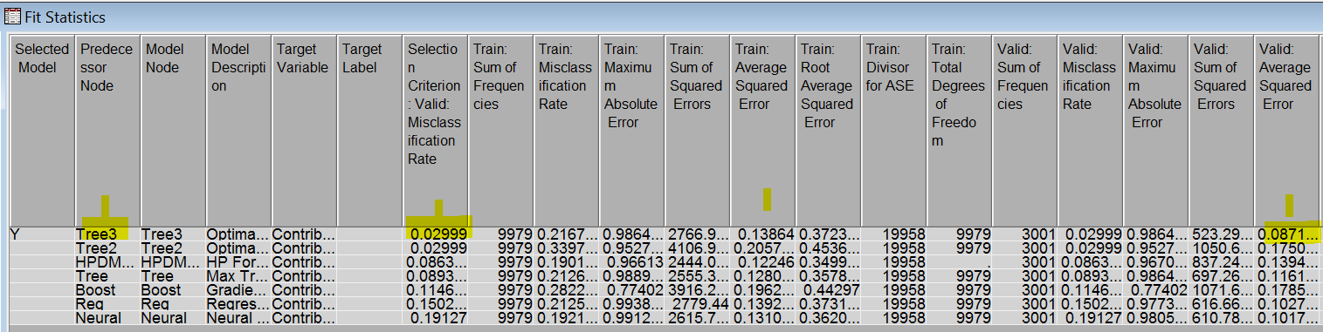
Model Comparison
The Optimal ASE decision tree model of all the predictive models seems to be predicting better with low average square error and low misclassification rate.

Slide 31
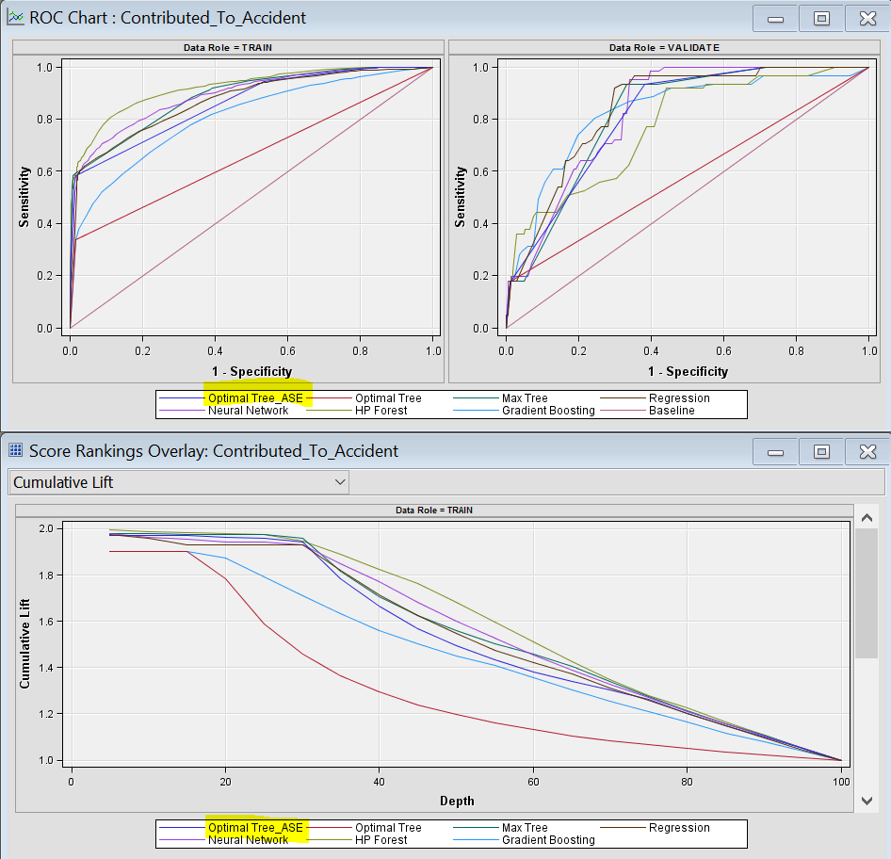
Model Comparison

Slide 32
Performance Tuning of The Best- Selected Model
Bagging: After identifying the optimal ASE tree to be the best model among the trained simple and ensemble models, the performance of the model was improved by applying the bagging algorithm.
Boosting: Like bagging, the boosting uses multiple sampling. But here, the samples are iteratively taken and on each iteration, the misclassification rate is recognized and corrected on its own. The same start group and end groups are used for the previously proven best tree, the optimal ASE tree.

Slide 33
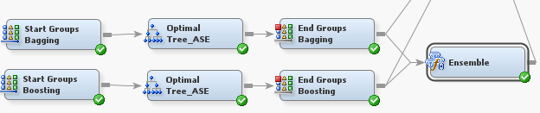
Ensemble
Ensemble: While bagging and boosting improves the performance of the model, the idea of building a hybrid ensemble model of both bagging and boosting models can drastically give excellent predictive model with least misclassification rate and least average square error.

Slide 34
Final Model Comparison
A comparison of the simple optimal tree ASE, bagged optimal ASE tree, boosted optimal ASE tree and the ensemble of bag & boost trees rightly showcases that the bagged optimal tree ASE tree is the best performing model with least validation misclassification rate and least average squared error.
The cumulative lift plot also clearly states that the bagged optimal tree is very good model with very high cumulative lift, well above the NO-MODEL baseline.

Slide 35
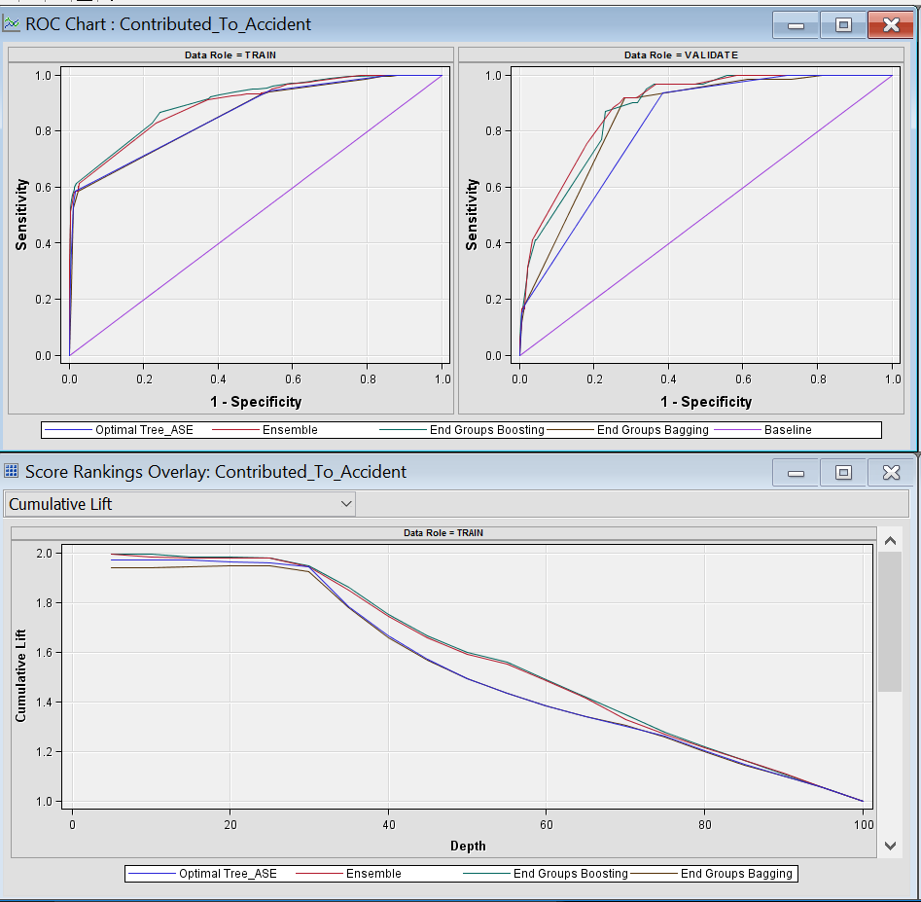
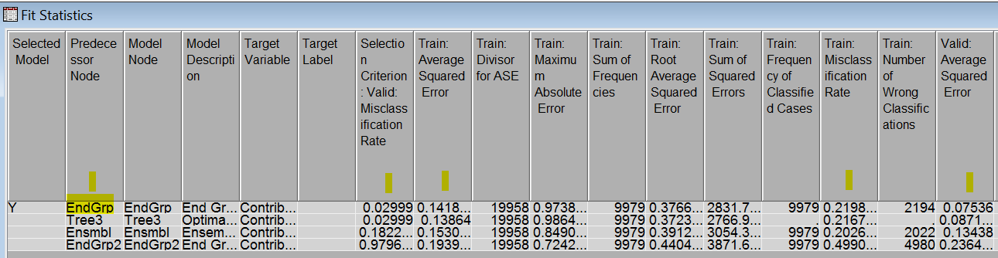
Fit Statistics and Cumulative Lift

Slide 36
Managerial implications/conclusions
We conclude with the following interesting findings from the model. Also, these findings can be used as a leverage to counter traffic violations which contribute to an accident.
Predicting the occurrence of an accident and enforcing the preventive measures is a dramatic feet of statistical application
18.03% of Accidents occur when Car Model is CIVIC, COROLLA, SONATA, CAMRY and will also result in property damage
72% of Accidents occur when the driver did not wear the seat belt, is driving a car of Mitsubishi, Chrysler company and does not have Commercial License
On a given day, accidents occur almost one and half times more post 4 pm than before it

